Slide 1


Slide 2
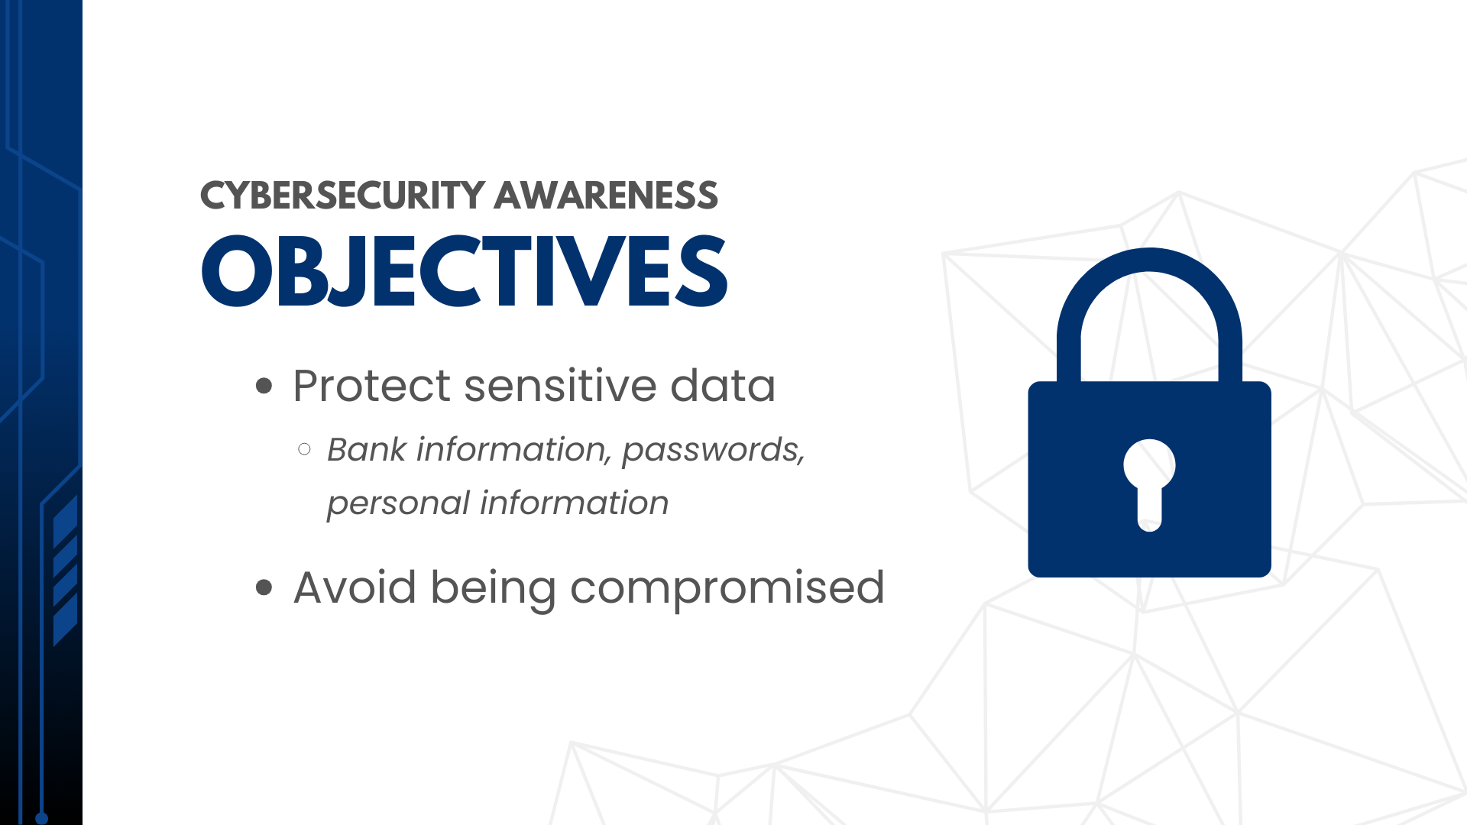

Slide 3
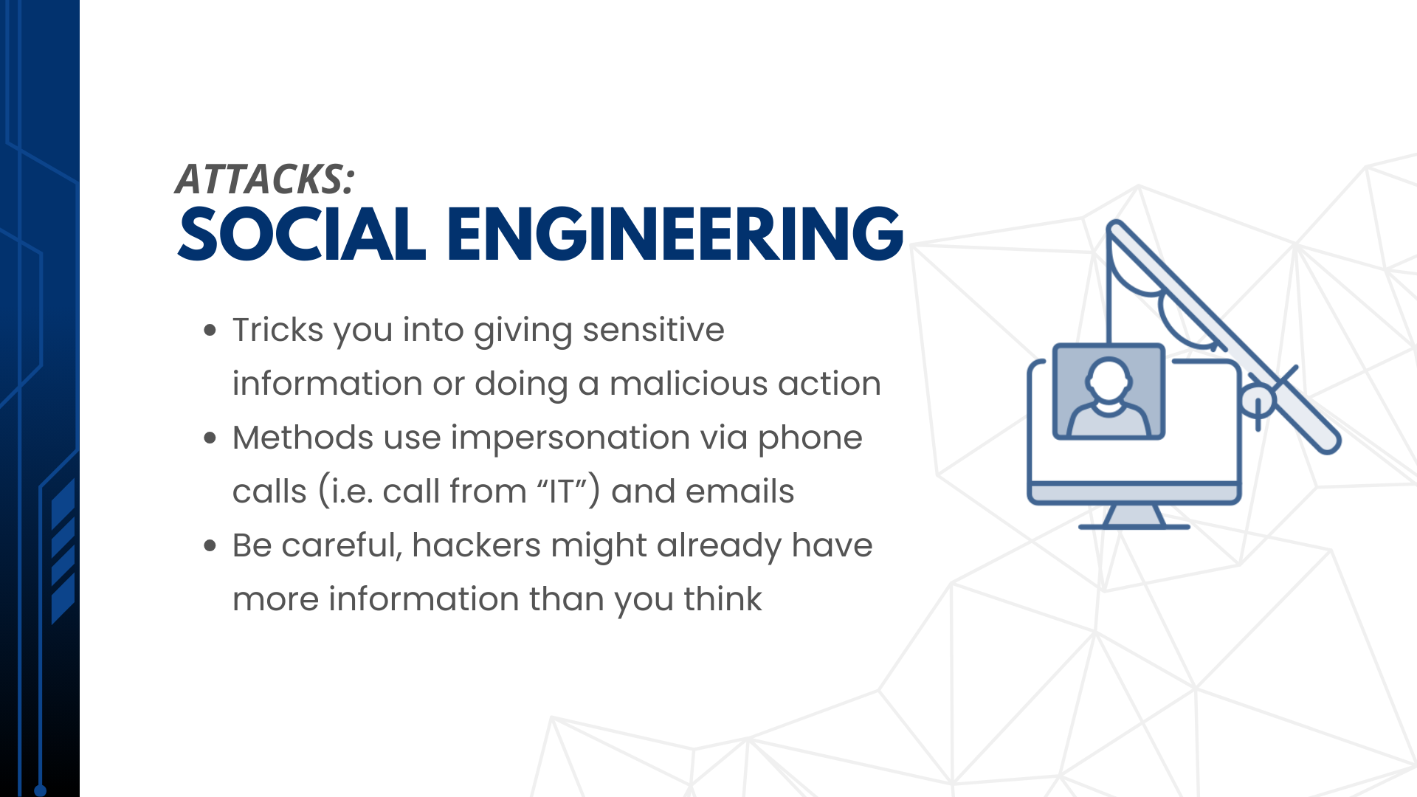

Slide 4
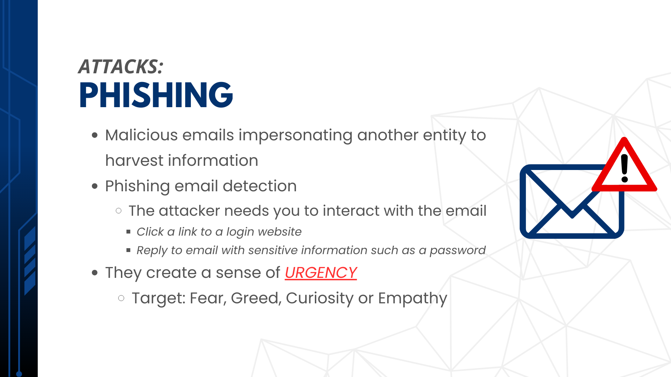

Slide 5
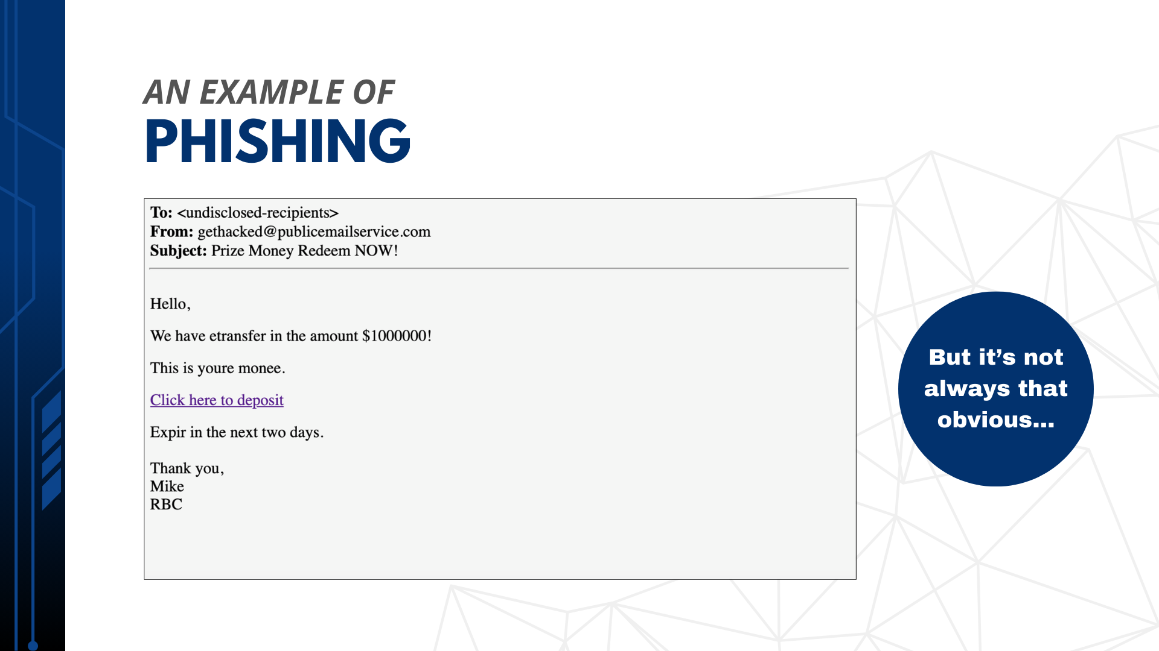

Slide 6
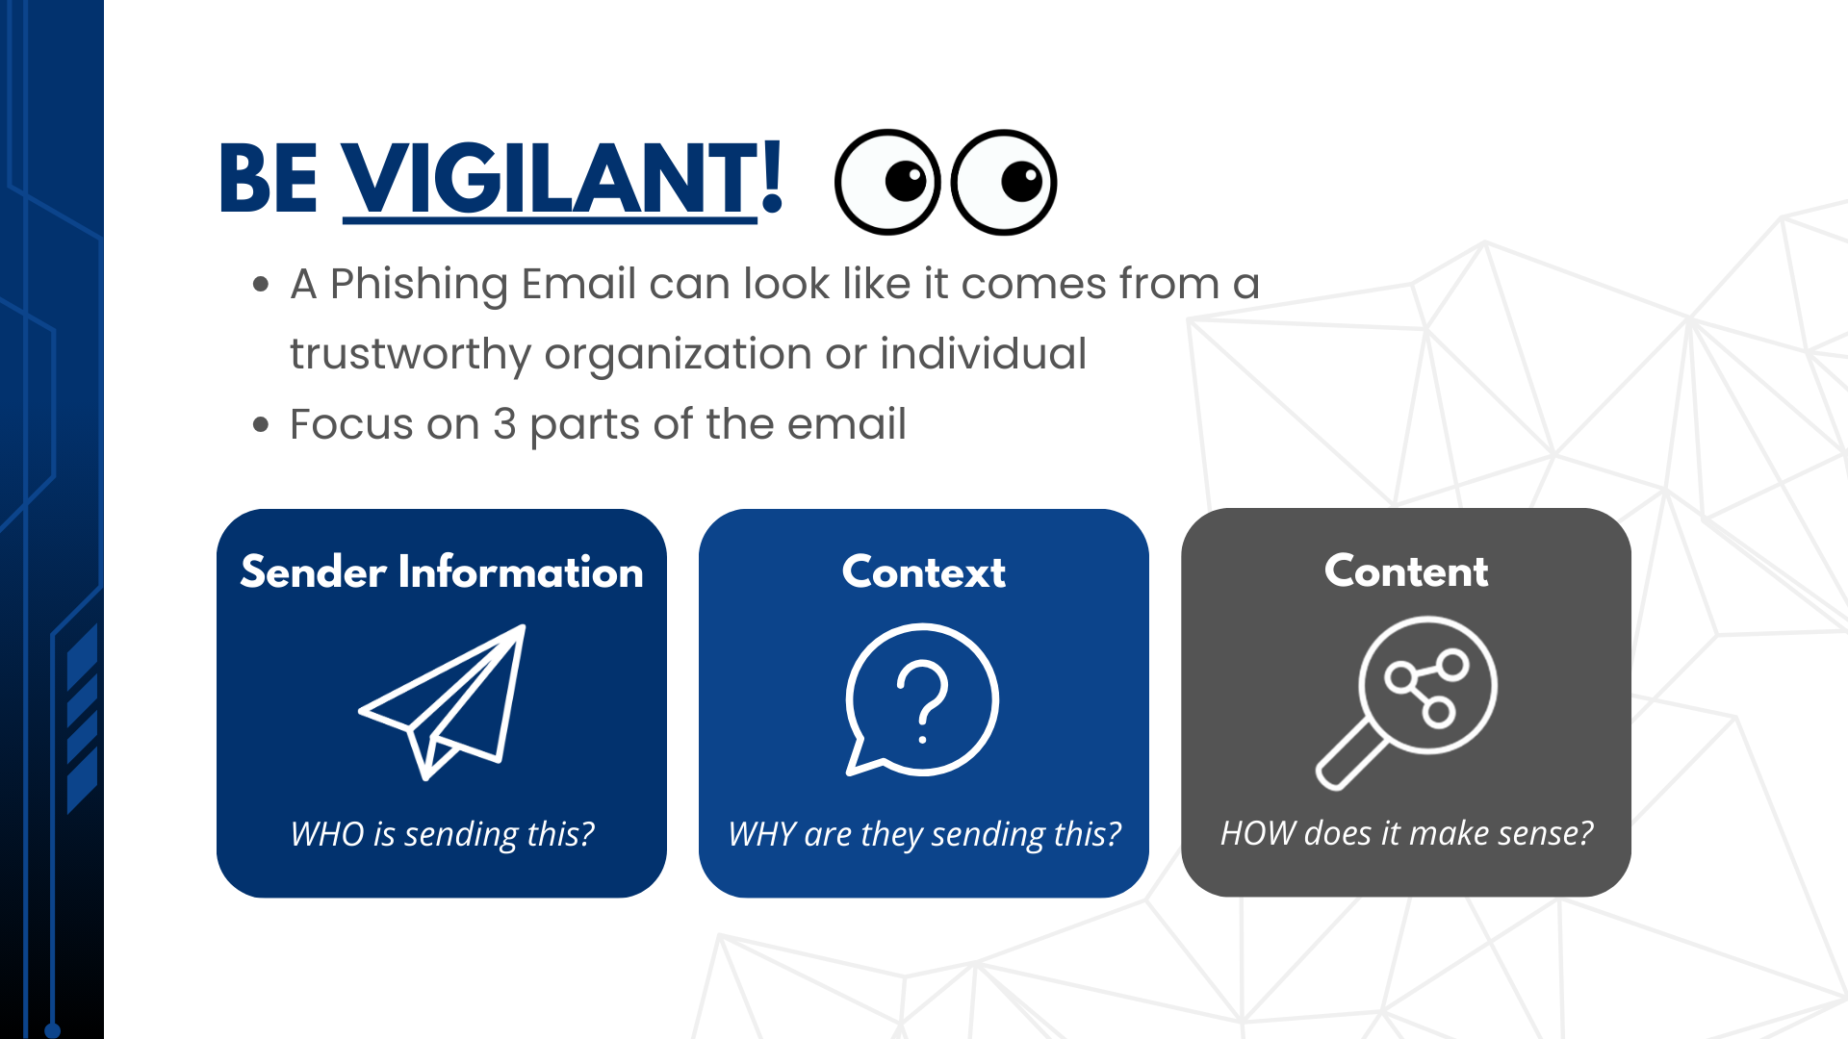

Slide 7
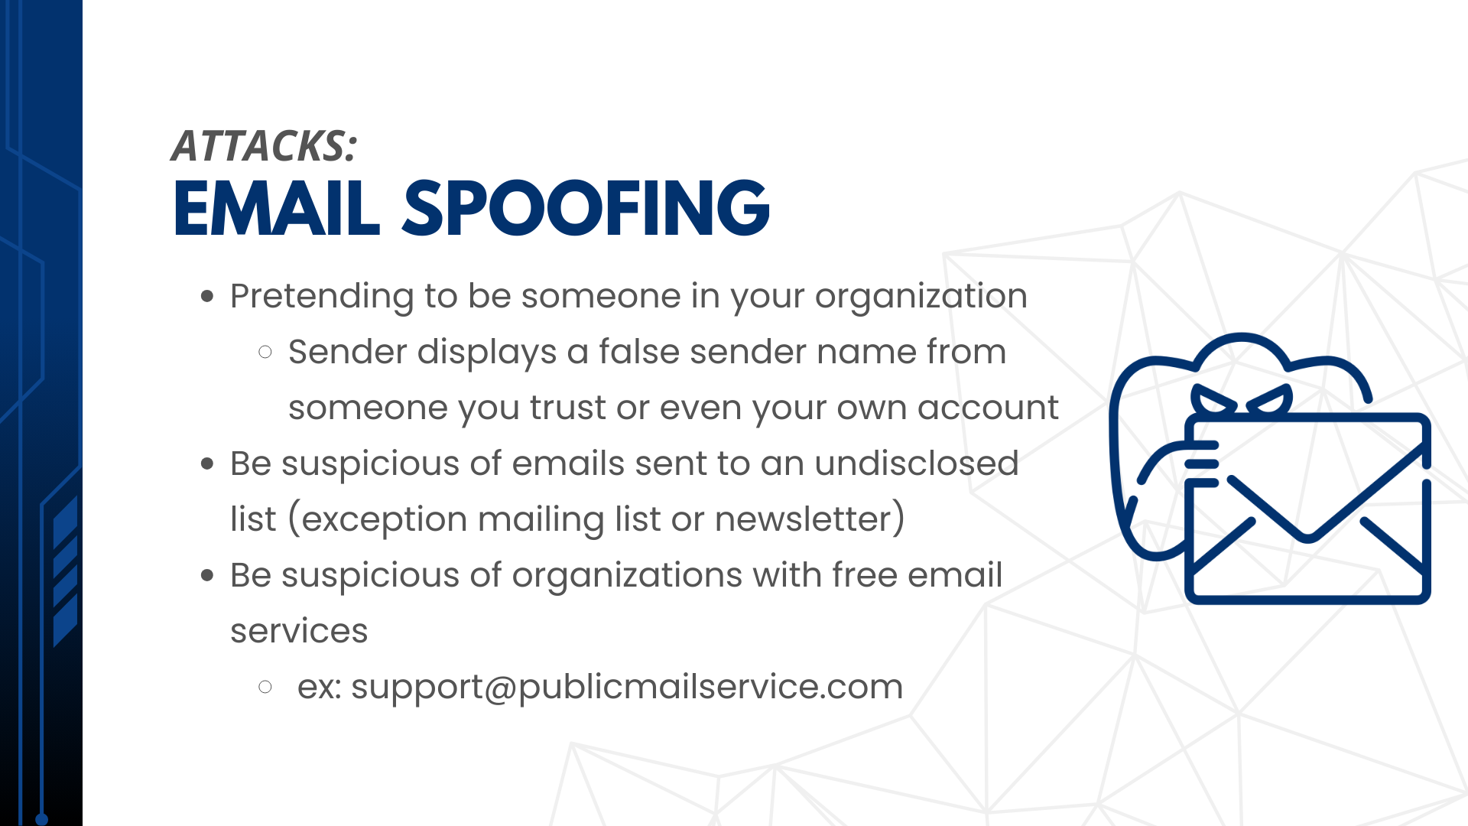

Slide 8
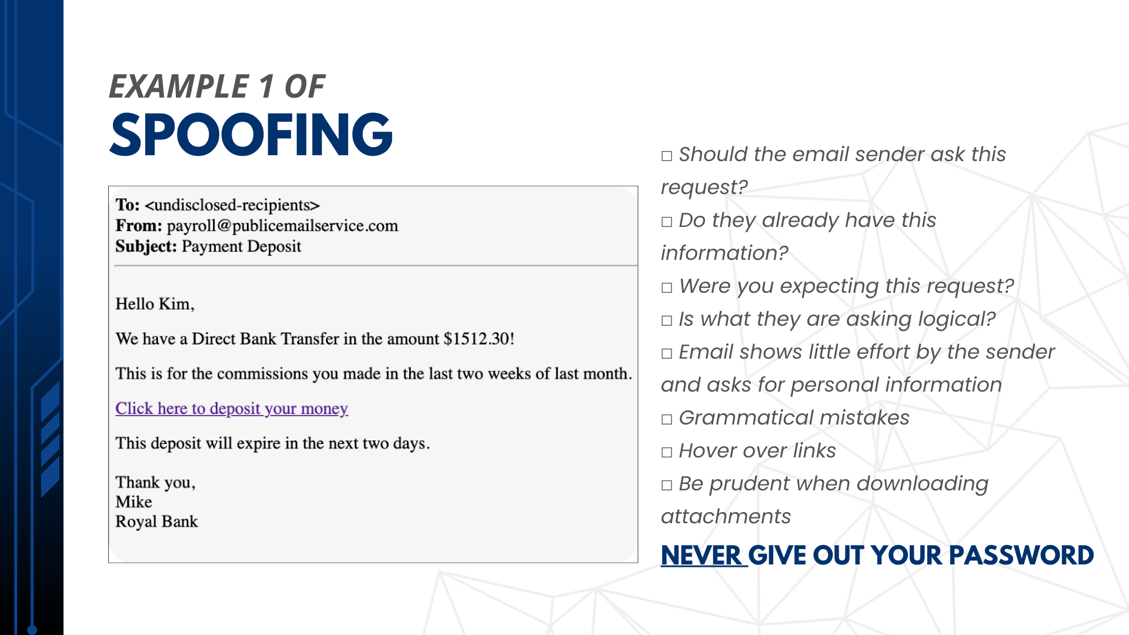

Slide 9
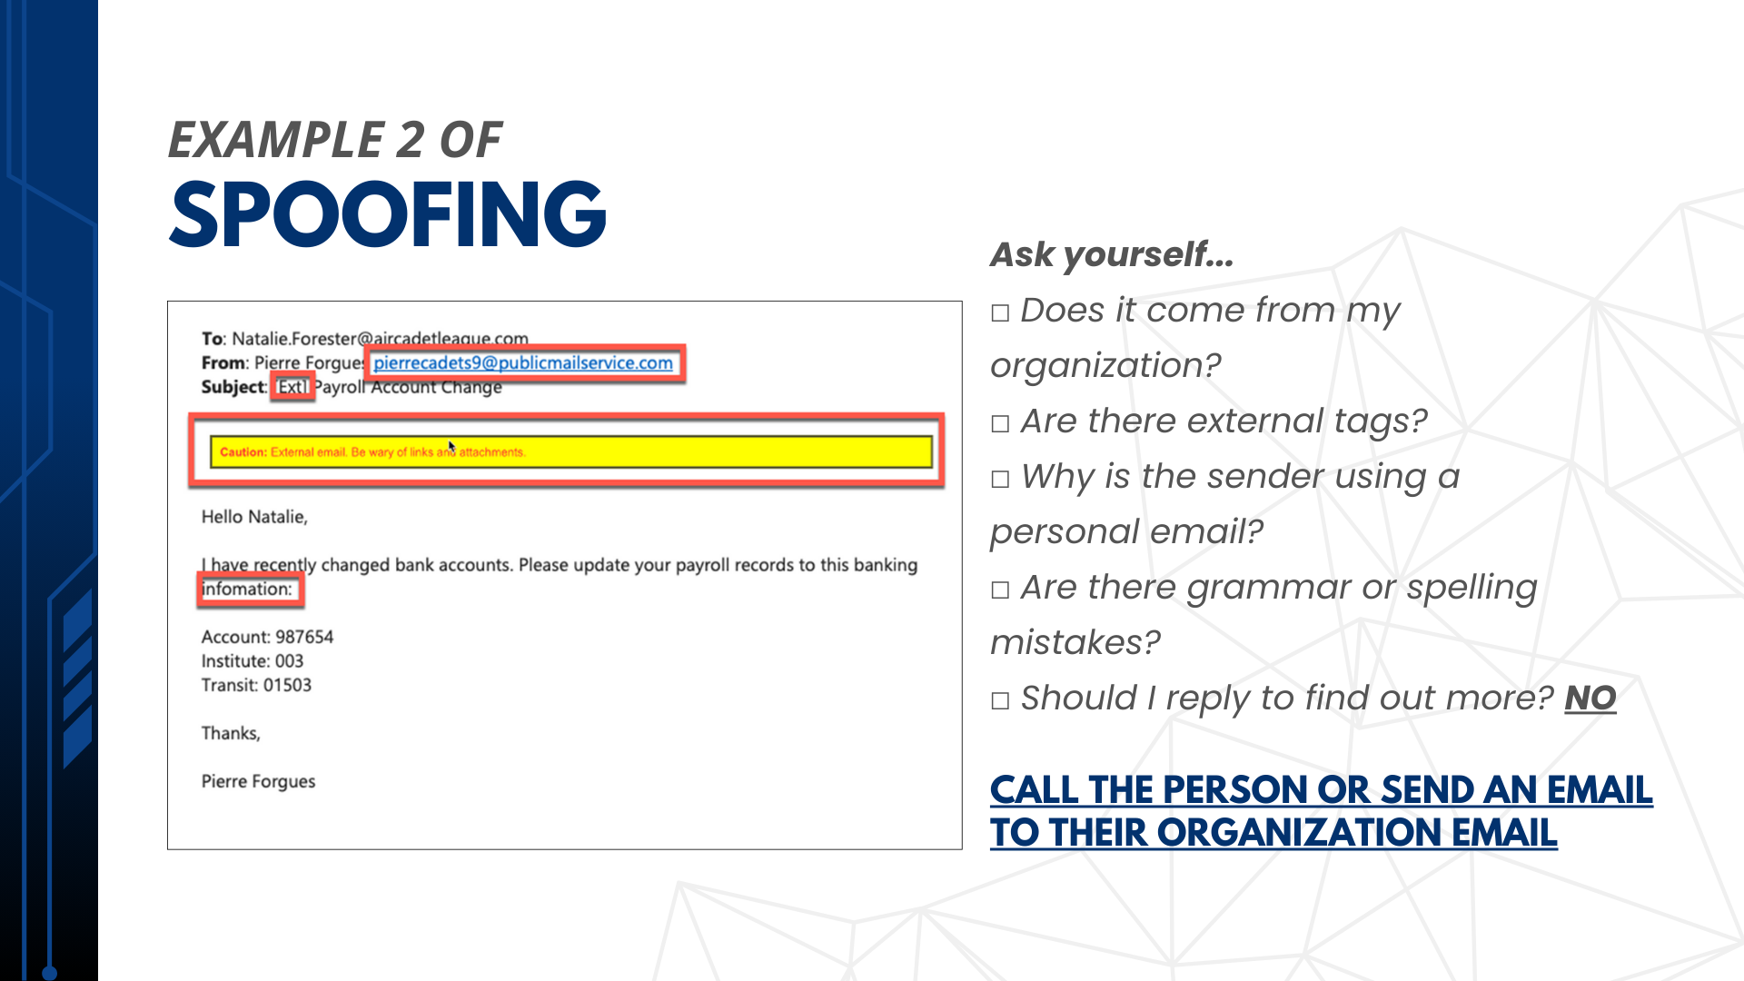

Slide 10
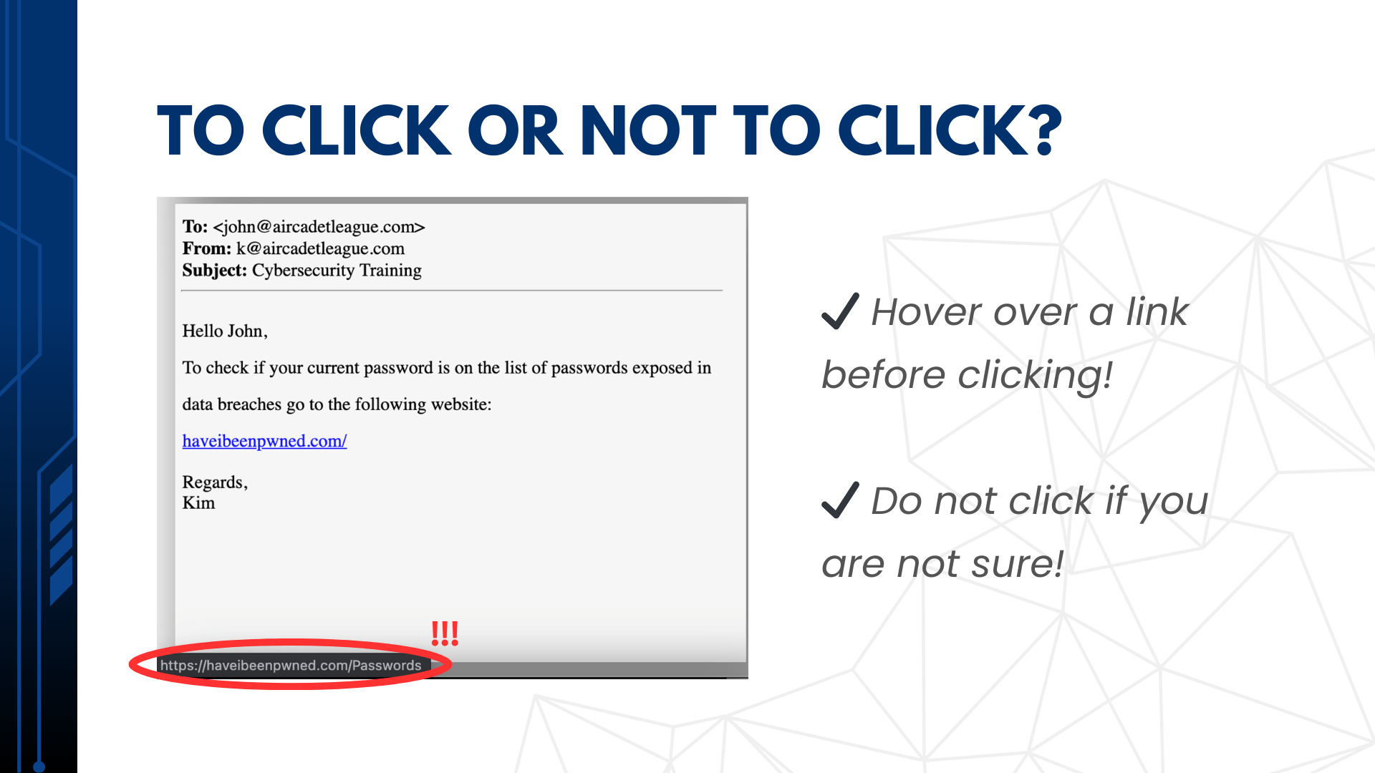

Slide 11





Slide 12
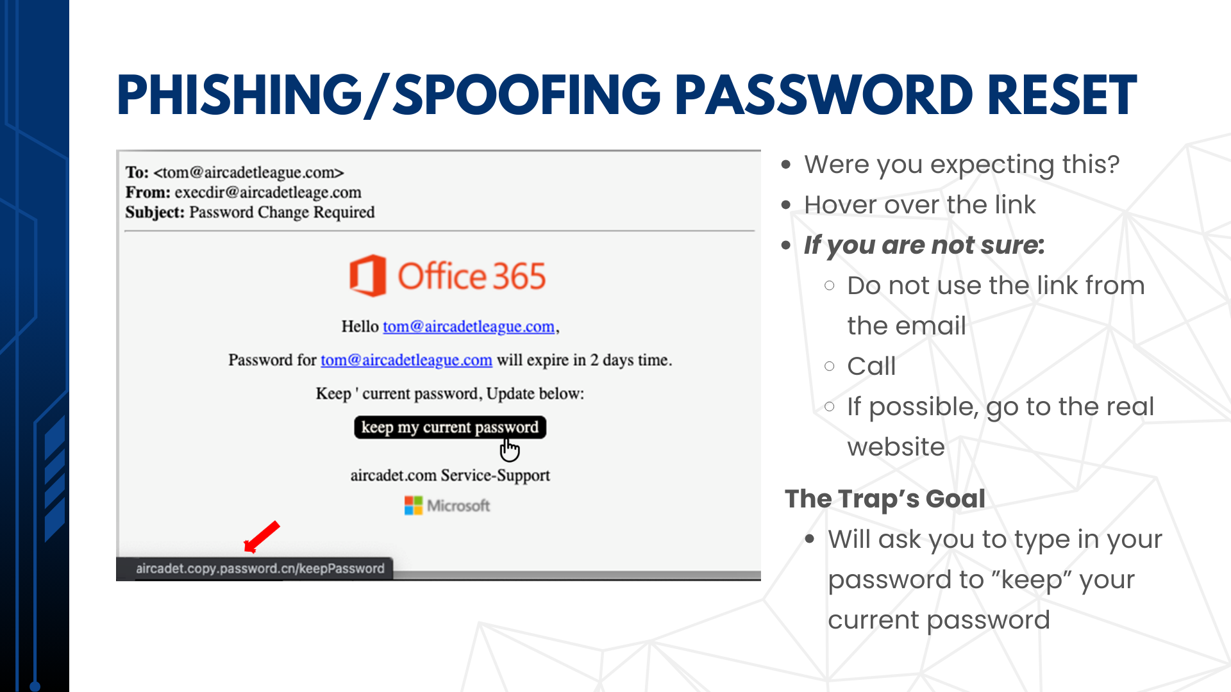

Slide 13
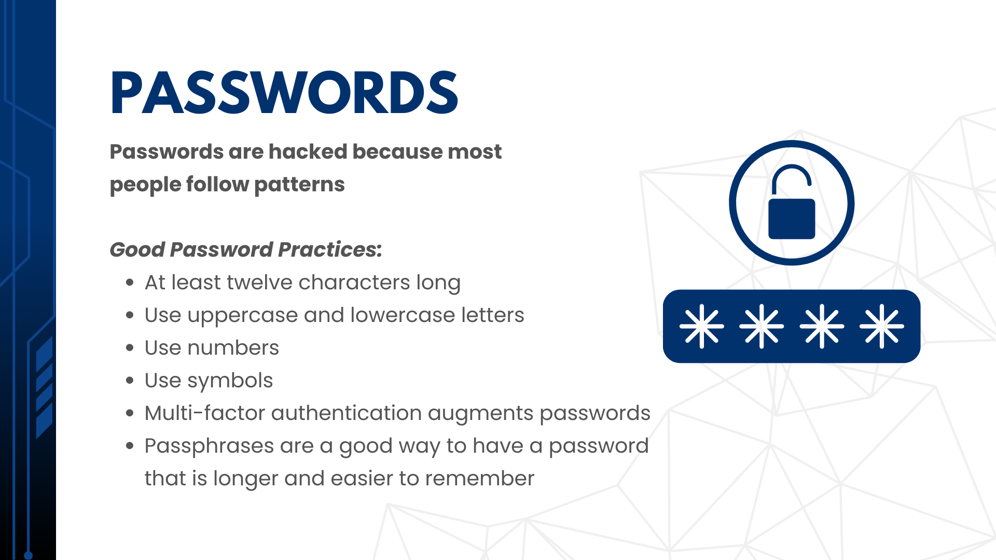

Slide 14
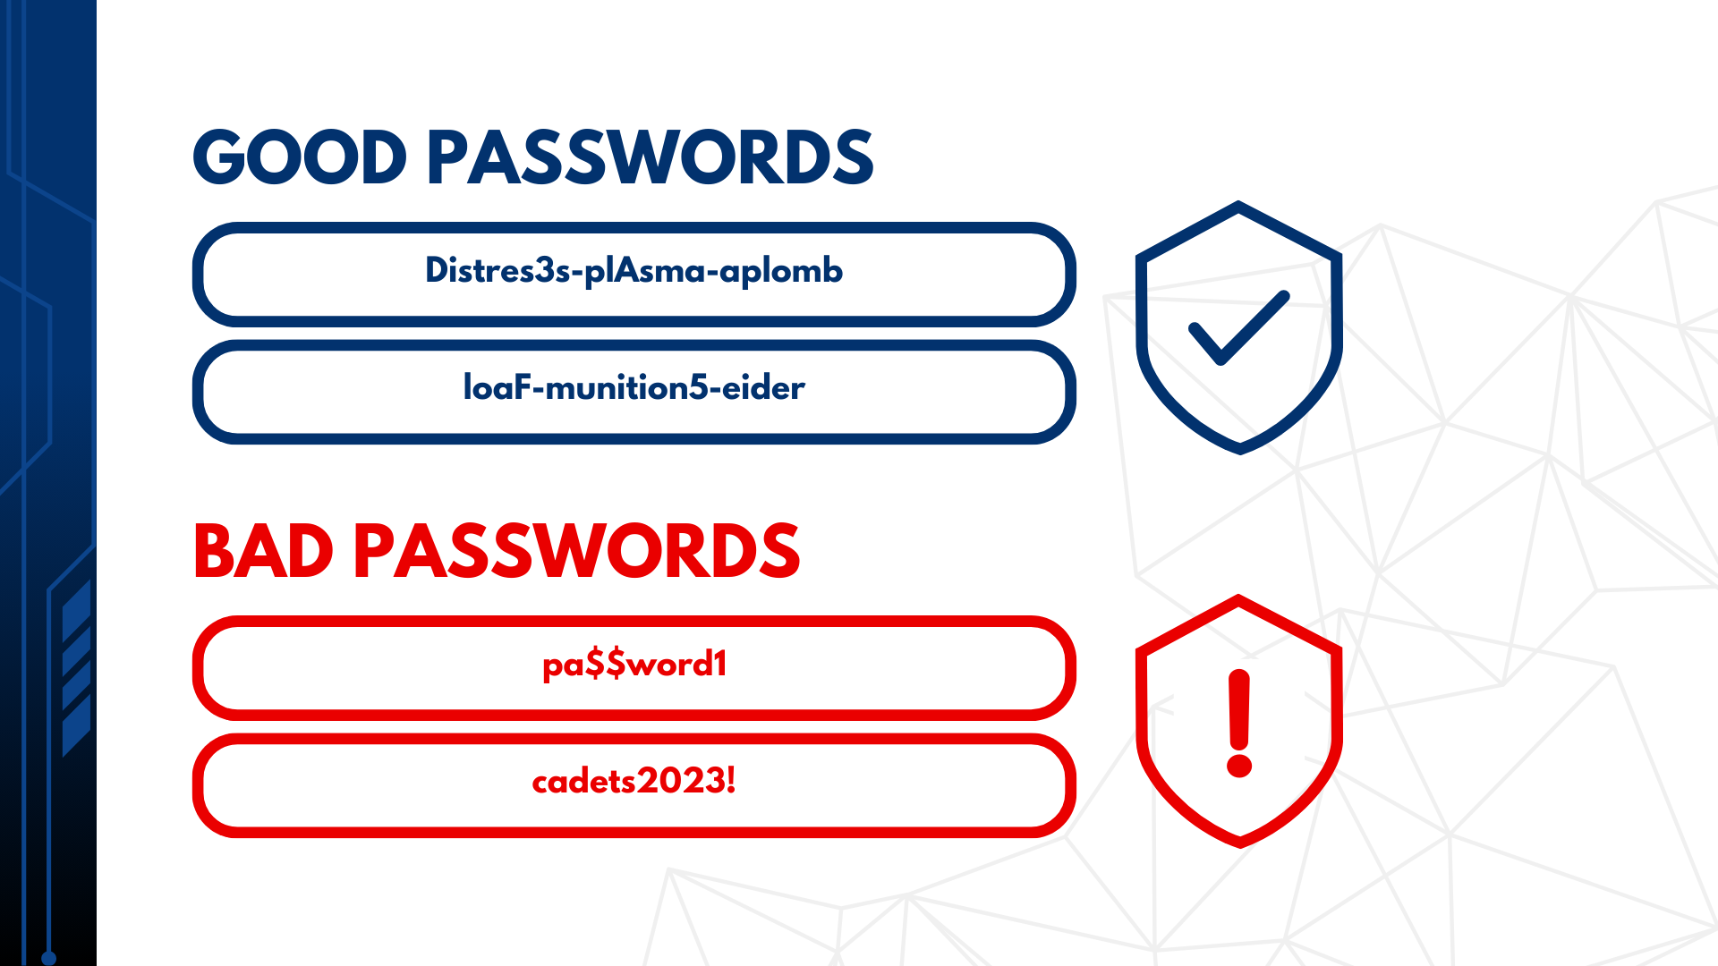

Slide 15
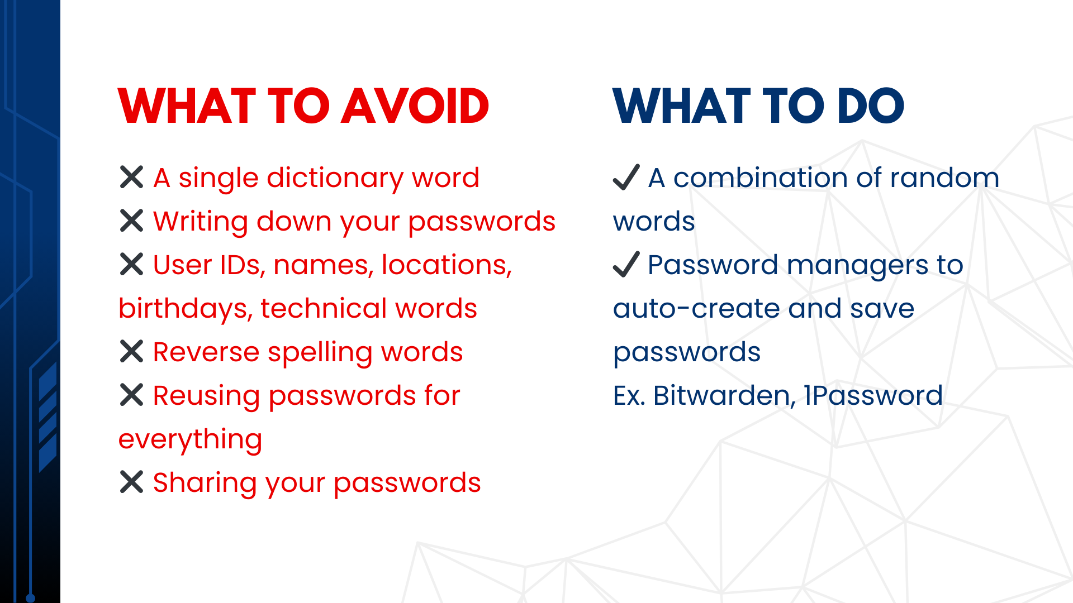

Slide 16
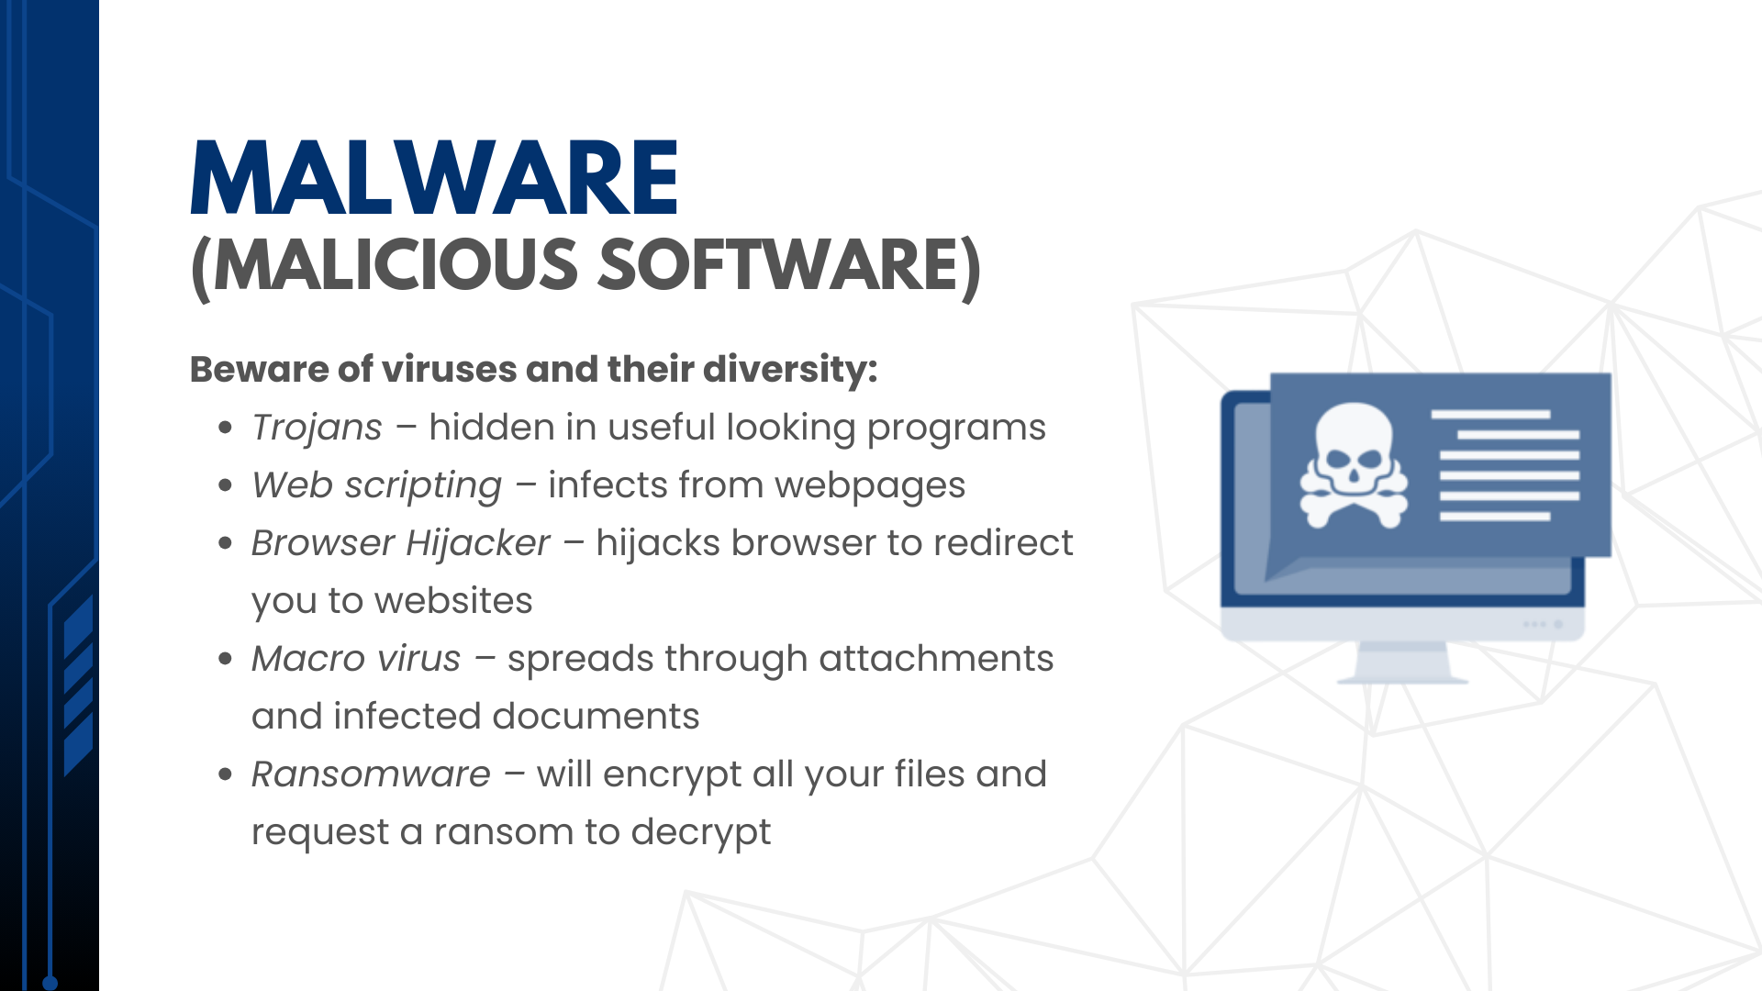

Slide 17
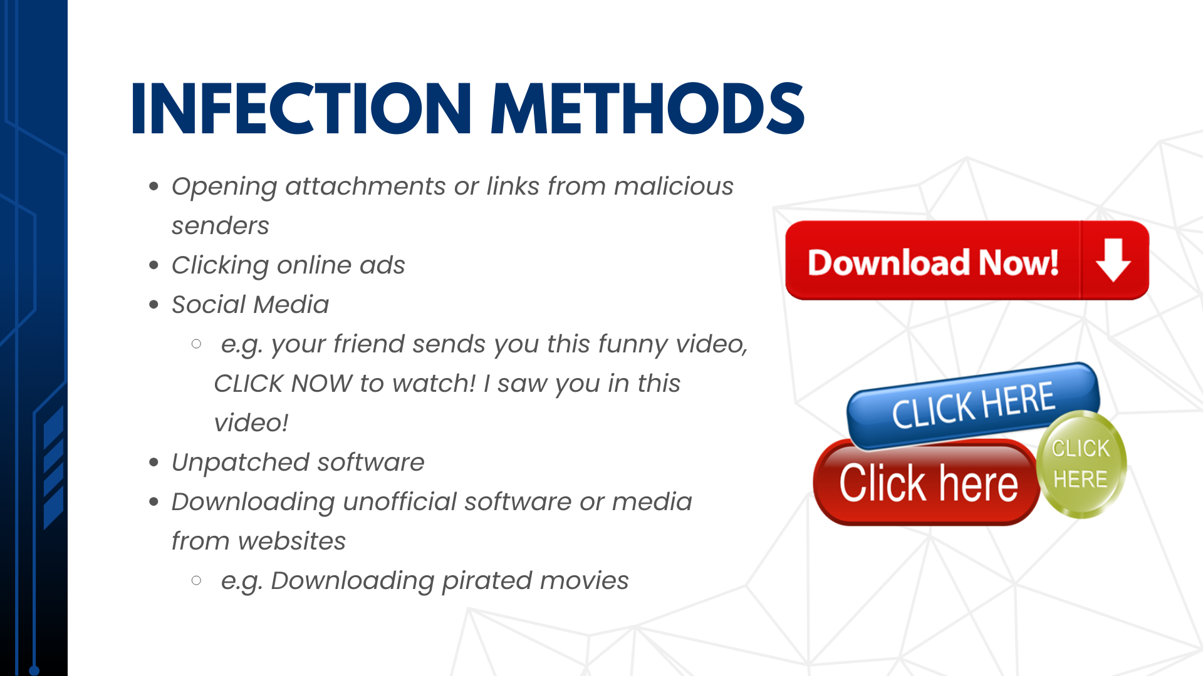

Slide 18
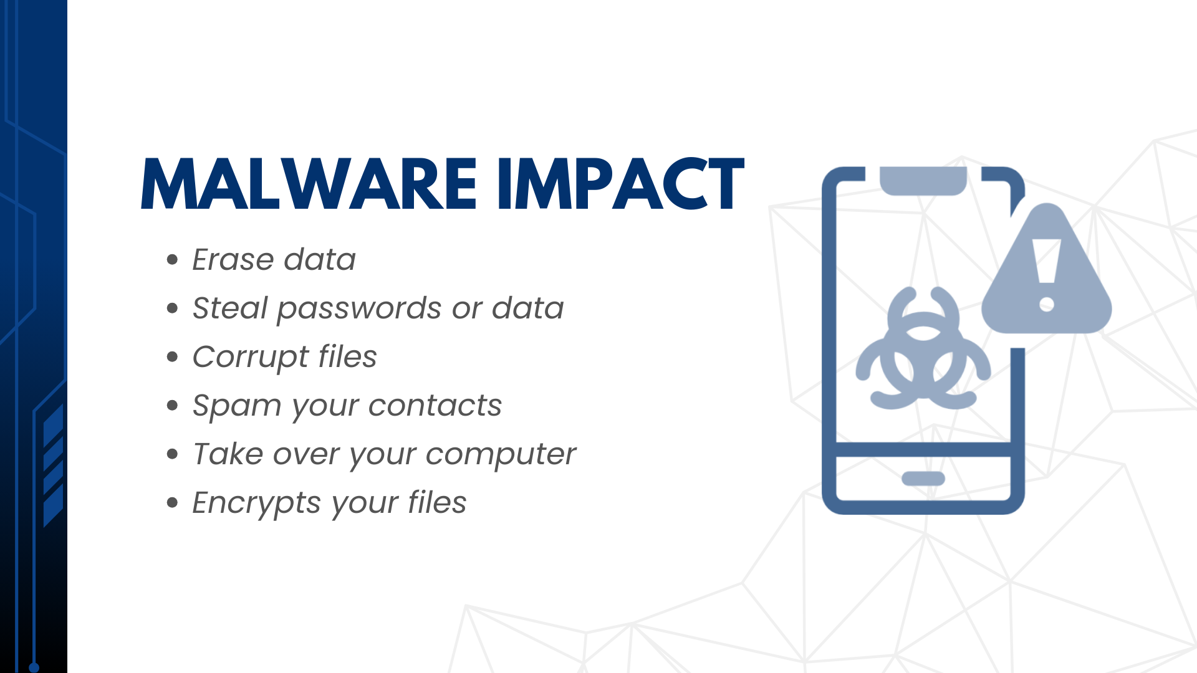

Slide 19
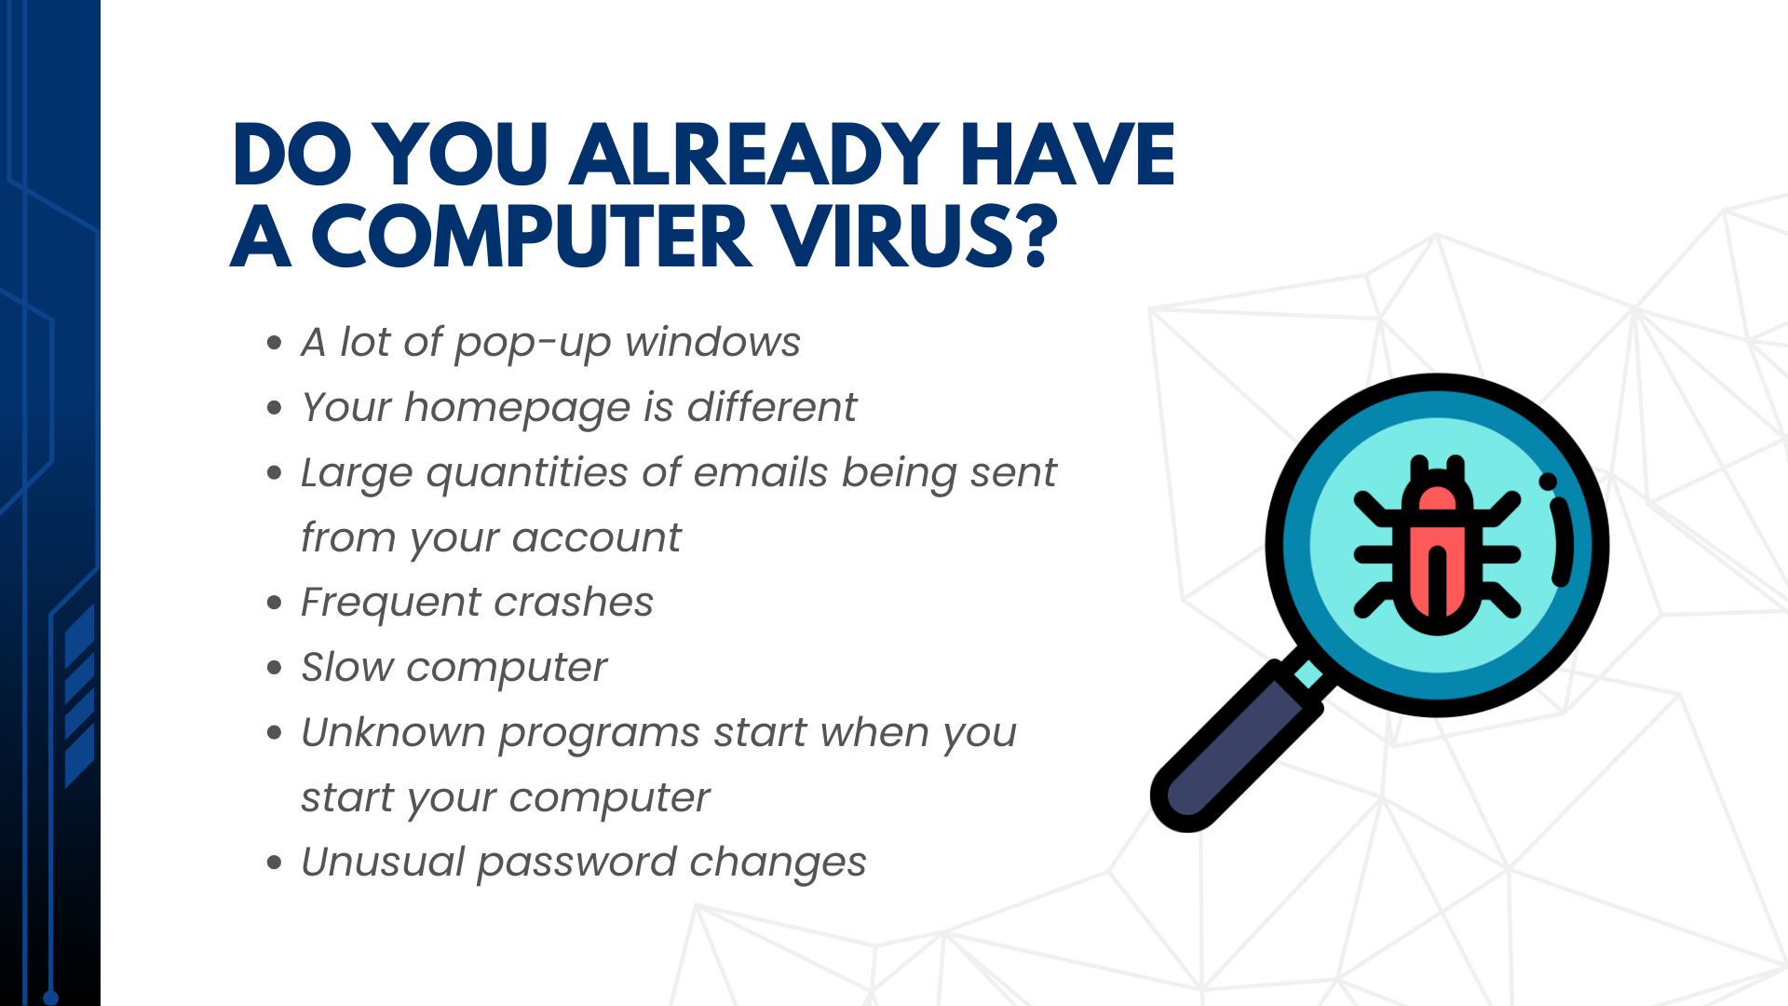

Slide 20
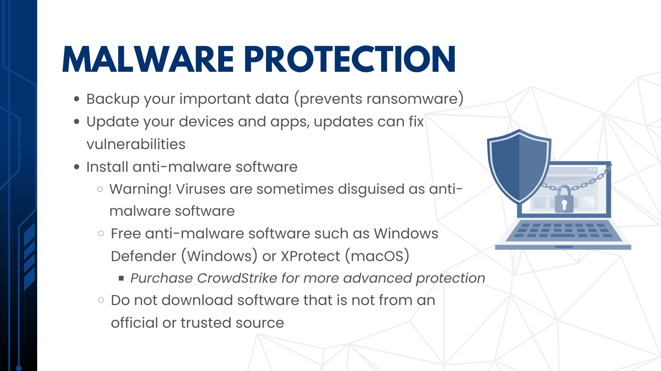

Slide 21
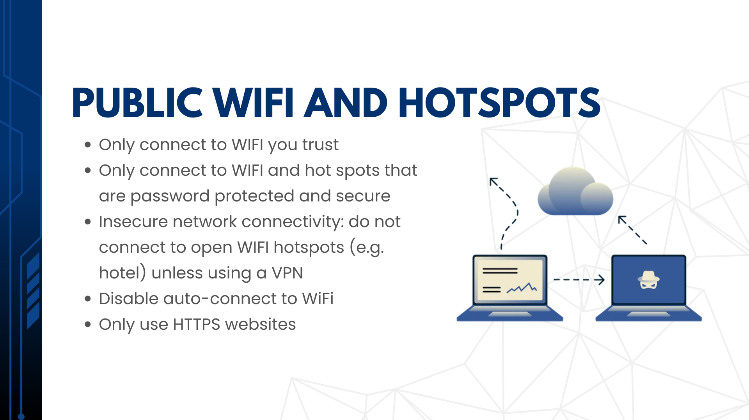

Slide 22
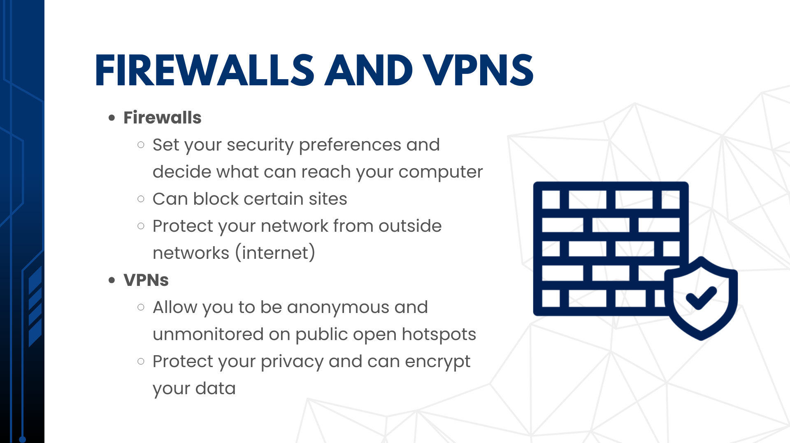

Slide 23
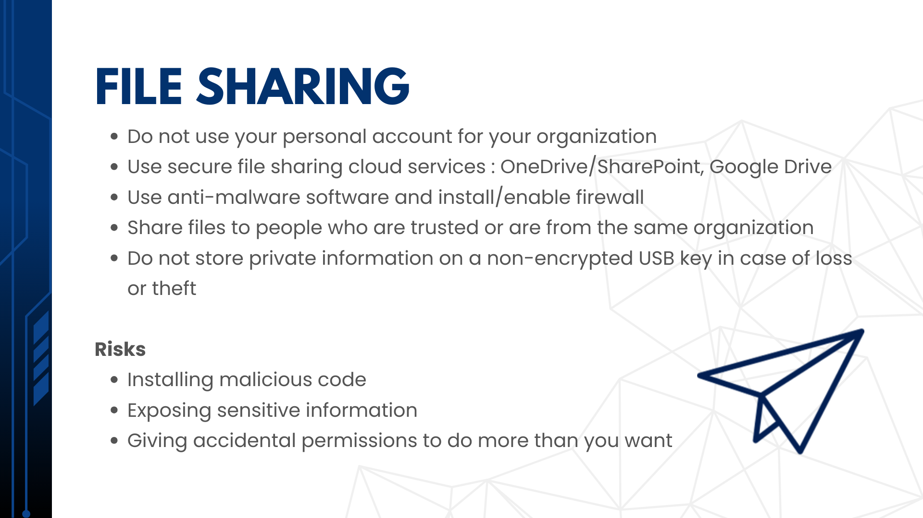

Slide 24
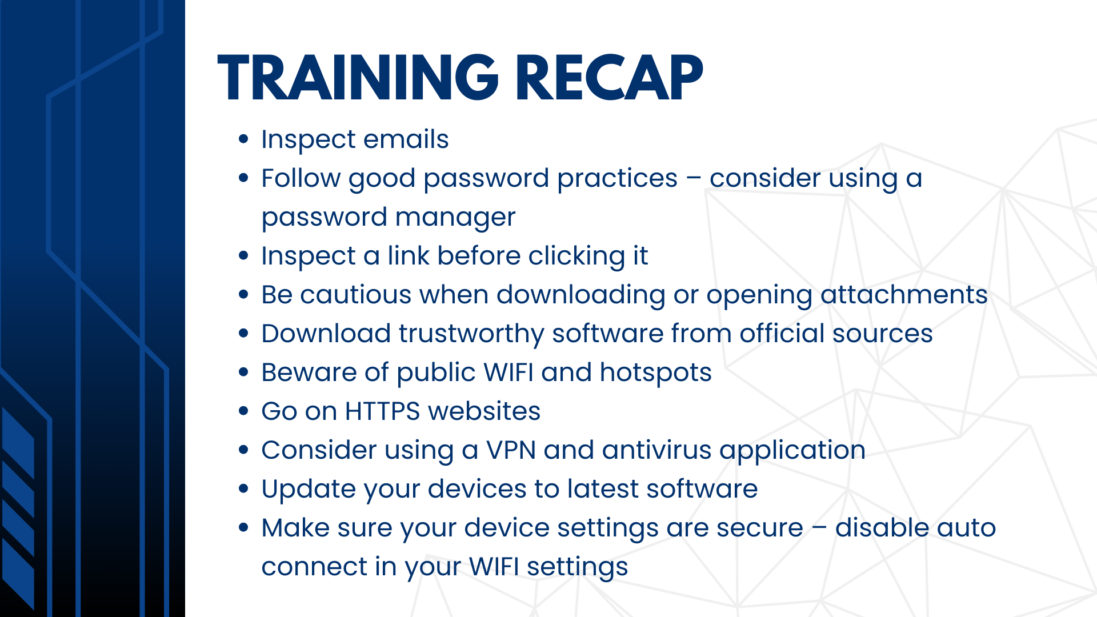

Slide 25


Slide 26


Slide 27

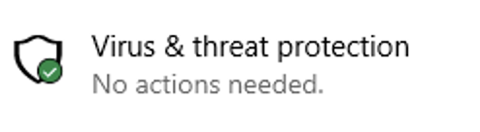
Windows Owner – Windows Defender
Real-time protection against spyware, viruses, and other malicious software
Click the start button (Windows button)
Windows security
Virus and threat protection
Virus and threat protection settings
Make sure Real-time protection is on
https://docs.microsoft.com/en-us/mem/intune/user-help/turn-on-defender-windows
Green Tick means an antivirus program is present. No action needed

Slide 28
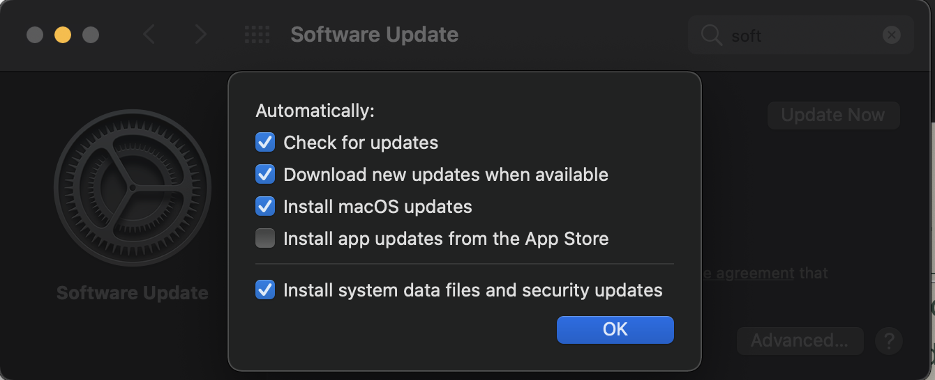
Mac owners - XProtect
Macs have a built-in basic antivirus (XProtect)
Checks applications you run and compares them to a list of known bad malware
System Preferences > Software Update > Install system data files and security updates (OS X 10.10 or later)
This will make sure XProtect is updated
https://support.apple.com/en-ca/guide/security/sec469d47bd8/web

Slide 29
Gmail – Two-Factor Authentication
Open https://myaccount.google.com/
Navigation panel > Security
Under “Signing in to Google” > 2-Step Verification > Get started
Follow steps on screen
https://support.google.com/accounts/answer/185839?hl=en&co=GENIE.Platform%3DAndroid

Slide 30
Microsoft – Two-factor authentication
1. Go to https://account.microsoft.com/security
2. Sign in
3. Select ”More security options”
4. Two-Step Verification > Set up two-step verification
5. Follow the instructions
https://support.microsoft.com/en-us/account-billing/how-to-use-two-step-verification-with-your-microsoft-account-c7910146-672f-01e9-50a0-93b4585e7eb4

Slide 31
How to set up two-factor authentication for Google Suites
https://support.google.com/a/answer/9176657?hl=en&ref_topic=2759193
Sign in> Google Admin Console with admin account> Security> 2-Step Verification.
  Allow users to turn on 2-Step verification
  Select Enforcement off (this will lock out users without 2FA)
Tell users to enroll with instructions:
  https://support.google.com/accounts/answer/185839
Optionally Select Enforcement but make sure everyone is enrolled

Slide 32
How to set up two-factor authentication in Microsoft Office Suite
Admin must enable MFA > Turn on Modern authentication for your organization
Check the following link:
https://docs.microsoft.com/en-us/microsoft-365/admin/security-and-compliance/set-up-multi-factor-authentication?redirectSourcePath=%252fen-us%252foffice%252f8f0454b2-f51a-4d9c-bcde-2c48e41621c6&view=o365-worldwide
User MFA set up:
Sign in like you normally would
You will be notified that more information is needed > Click Next
Set up the default free Microsoft Authenticator app on your mobile device
https://support.microsoft.com/en-us/office/set-up-your-microsoft-365-sign-in-for-multi-factor-authentication-ace1d096-61e5-449b-a875-58eb3d74de14?ui=en-US&rs=en-US&ad=US

Slide 33
References
[1] A. Grace, “What Is A Computer Virus?” https://us.norton.com/internetsecurity-malware-what-is-a-computer-virus.html.
[2] Crystal Bedell, P. Loshin, and K. Hanna, “What is a computer worm and how does it work?,” SearchSecurity. https://searchsecurity.techtarget.com/definition/worm.
[3] ENOUGH IS ENOUGH, “A Guide to Public Wifi Security Risks & How to Use it Safely,” Internet Safety 101. https://internetsafety101.org/publicwifisafety.
[4] United States Government, “Risks of File-Sharing Technology | CISA,” Cybersecurity and Infrastructure, 2010. https://us-cert.cisa.gov/ncas/tips/ST05-007 (accessed Jul. 26, 2021).

