Slide 1
Air Cadet League of Canada - Annual General Meeting
16 June 2018
BGen K.L. Woiden, Commander
National Cadet and Junior Canadian Rangers Support Group

Slide 2
Agenda – Air Cadets
Commander’s Intent and Priorities
Legalization of cannabis in Canada
Use of Volunteers
Strategic Policy Alignment
Cadet and JCR Renewal
Outreach, Evaluation, and Validation
National Competitions
Air Cadet Program
  Nationally Directed Activities – International & Domestic
  Resource Management
  Design and Development

Slide 3
Commander’s Intent
Focus on Cadets and JCRs:
    Develop Cadets and JCRs to be effective leaders and positive contributors to their communities now and into adulthood;
    Adapt to evolving needs and interests of youth; and
    Maintain a safe and respectful environment.

Slide 4
Commander’s Intent
Build and Deliver Quality Programs that are:
    Challenging, fun, exciting and unique experiences and opportunities;
    Led by passionate, well trained adult staff and volunteers; and
    Achievable, affordable and sustainable.

Slide 5
Commander’s Intent
Ensure Program Success through:
    Continuous improvement of activities, services and processes;
    Effective stewardship of resources; and
    Co-operation with communities who both support and benefit from the program.

Slide 6
Commander’s Priorities
Operation Honour
  Harmful and Inappropriate Sexual Behaviour (HISB) reporting
  Code of Conduct
  PYDPO update
Continue Executing the CCO Program
  Program excellence
Renewal
  In final Phase
Maintain and Strengthen Partnerships
  Leagues
  Community

Slide 7
Legalization of Cannabis in Canada
Two DAODs currently under development:
  the first will include restrictions on the consumption of cannabis by CAF Members
  the second will restrict use/possession on Defence Establishments
The following CATOs will need to be updated:
  CATO 12-50 Inspections - specifically Annex B listing prohibited, restricted and unauthorized items found during inspections.
  CATO 23-07 Civilian Volunteers in Support of Cadets - para 21 requires volunteers to report a change in circumstances including being arrested for or suspected of drug use.

Slide 8
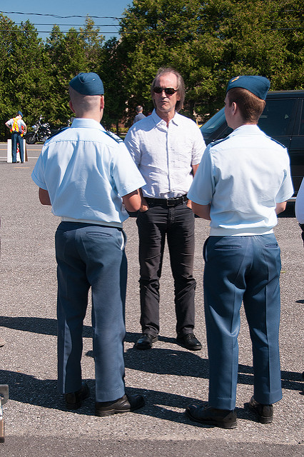
Use of Volunteers
Under the MOU working group, we have been discussing issues linked to volunteer involvement with the program:
  Supervision of cadets and cadet
  activities by civilian volunteers
  Volunteer management and
  screening
  Civilian volunteer liability

Slide 9

Strategic Policy Alignment
Canada’s Defence Policy (SSE): Cadets and Junior Canadian Rangers (Youth Program) profiled on:
  - Pg 70: Section on “Strengthening Canadian Communities by Investing in Youth“.
  - Pg 80: The Junior Canadian Rangers is mentioned again in a paragraph related to the policy intent to expand and deepen extensive relationships with Indigenous communities, particularly through the Canadian Rangers and Junior Canadian Rangers.
SSE Implementation Plan: Accounts for the 111 specific initiatives that was published in the Defence Policy plus additional Initiatives that were eventually extrapolated from it. This includes Initiative C “Strengthen Canadian Communities by Investing in Youth”.

Slide 10
Departmental Results Framework (DRF)
Transition to a New Architecture
Linked to Core Responsibility 3 (Defence Team):
Includes “Strengthen Canadian Communities by Investing in Youth” in CR description
Linked to Promote Canadian Interests & Values
Departmental Results
Framework
Departmental Results
Framework
Strategic Outcome
Strategic Outcome
Core
Responsibility
Core
Responsibility
Core
Responsibility
Core
Responsibility
Linked to: Program 2.0 Defence Services & Contributions to Government
Sub-Program 2.3 Military Heritage & Outreach
Departmental Result/Indicator 3.5:
Youth in Canada are provided with experience and opportunities that enable a successful transition to adulthood.
% of the target Canadian youth population that participates in Cadets and Junior Canadian Rangers
PAA Program
PAA Program
PAA Program
Results and Indicators
Results and Indicators
Resultnd Indicators
Expected Result
Expected Result
Sub-Programs or Sub-Sub Programs
Sub-Programs or Sub-Sub Programs
Sub-Sub-Program 2.3.2 Youth Program
Program
Inventory
Program
Inventory
Program
Program 3.10: Cadets and Junior Canadian Rangers (Youth Program)
Program
Program
Program
Program
Program
Program
Program
Program
Program
Program
Operational Level
Expected Result

Slide 11

Cadet and JCR Renewal
On track for formal close-out in FY 18/19 and transition to a continuous improvement posture:
  This includes closing out reporting back to ADM(RS)
  New/Follow-up evaluation requirements will be accounted for as part of the new Departmental Results Framework (DRF)
Recent and Upcoming Working Group Meetings:
  Uniform Modernization (29 Jan – 2 Feb 18)
  Civilian Organization and Establishment (8 Feb 18)
  Cadet Growth and Sustainability (11-23 Mar 18)
  Youth Voice (18-23 Mar 18)
  CTC Organization and Establishment (3-13 Apr 18)
  Unit Leadership Team Review (8-13 Apr 18)
  CAF Familiarization (22-27 Apr 18)
  DND/League MOU WG (Ongoing)
  League Costing WG (New/Initiating Phase)

Slide 12
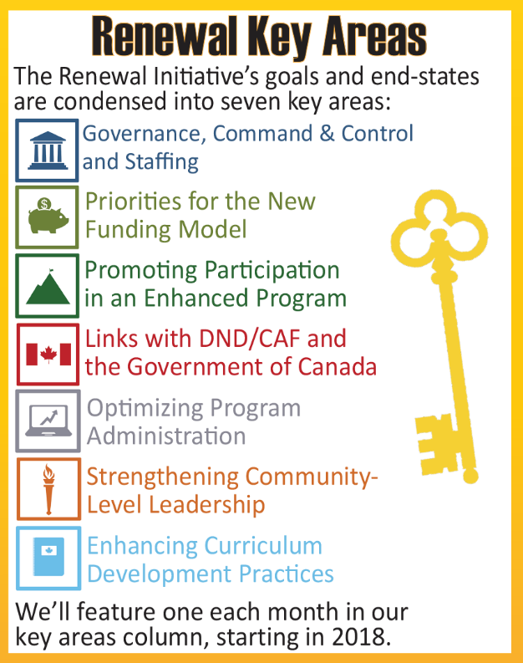
Coming Soon: Renewal in Review
Renewal in Review:
  New comms tool focused on the results of Renewal
  Review what Renewal has accomplished
  Feature members of the organization who have experienced the results of Renewal
  Revisit recommendations that have been implemented over the course of Renewal or that are intended to be implemented post-Renewal
Forward:
  Continue highlighting progress, positive change and new ideas within the organization.

Slide 13
Outreach, Evaluation & Validation - Continuous Improvement
The Outreach, Evaluation and Validation (OEV) Section provides advice to the Command team and support to staff and stakeholders in order to enable the continuous improvement of training programs through data gathering, analysis and knowledge sharing that facilitates evidence-based decisions and informed action.
Accomplished through:
- Needs Assessment, Evaluation, Validation (relation to CFITES)
- Coordinating research and scanning for contemporary information through existing research
- Performing Outreach with CAF, OGDs, NGOs and a wide spectrum of youth-serving agencies

Slide 14
Outreach, Evaluation and Validation Plans 2018
Evaluation – CTC 2018
  Conducting a full evaluation of the Drill and Ceremonial Instructor Course
  Continuing evaluation of Zone Training Officer and BOTC pilots
Validation FY 18/19
  Continuing validation of CIC training
Outreach
  Facilitating CCO Youth engagement with Canada Service Corps
  Continued Engagement with NYSA
  Exploring MoUs with RCMP and Royal Canadian Legion in collaboration with Leagues
  Participating in CAF Outreach WG

Slide 15
National Competitions - Common
National Biathlon Championship 2018
  Brookvale, PEI
  6 to11 March 2018
  130 competitors, 19 cadet coaches and 20 adult coaches, 35 staff (support and officials), 50 cadet officials
National Marksmanship Championship 2018
  Victoria, BC
  6-11 May 2018
  125 cadets, 15 cadet officials, 29 staff (support and officials)

Slide 16


Nationally Directed Activities – International – Air Cadets
  International Air Cadet Exchange – Outbound
    17 July – 2 August
    Australia, Belgium, China, France, Hong Kong, Netherlands, New Zealand, South Korea, Switzerland, United Kingdom and United States
  International Air Cadet Exchange – Inbound
    17 July – 2 August
    Hosted by Atlantic Region (NB, NS & PEI)
    Australia, Belgium, China, France, Hong Kong, Netherlands, New Zealand, South Korea, Switzerland, United Kingdom and United States

Slide 17

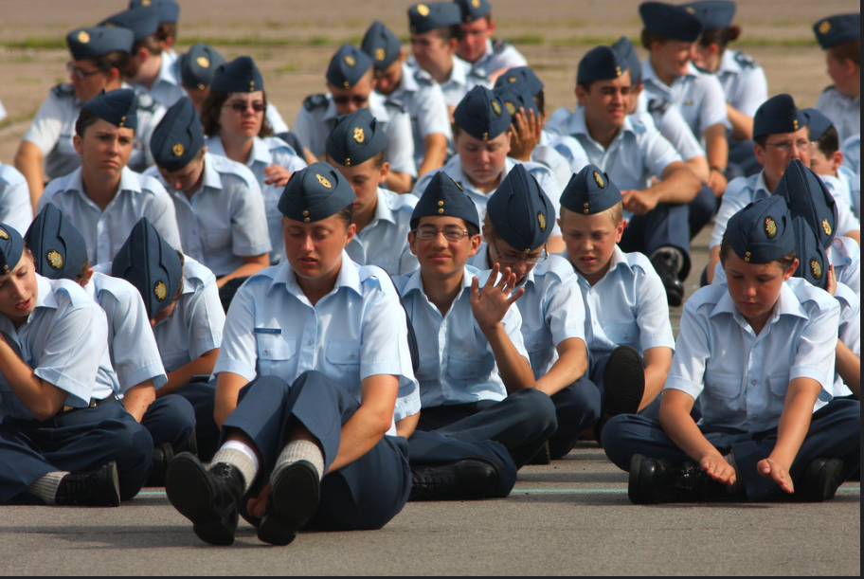
Nationally Directed Activities – Domestic – Air Cadets
  2018 Vintage Wings Program
    St-Jean, Trenton and North Bay
    Summer Training 2018

Slide 18
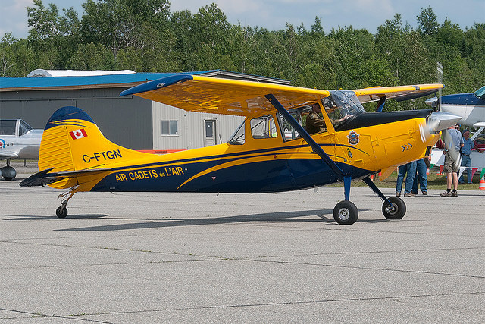
Nationally Directed Activities – Domestic – Air Cadet Flying Program
Air Cadet Power Pilot Scholarship
  Fair Open Transparent
  Open to more Canadian Flight Schools
  Instructor Availability
Tow Aircraft Replacement
  L-19 Fleet replacement options

Slide 19
Resource Management – Air Cadets
Life Cycle Material Management Plans
  Due this summer
Rifles
  Goal of this project is to standardize, modernize, and rationalize the rifle fleets
  Rifle Rationalization Plan is being staffed for approval
Canoes/Kayaks
  Develop a long-term acquisition, maintenance and life-cycling plan
  Recreational Watercraft (Canoe/Kayak) Rationalization Plan is being staffed for approval

Slide 20
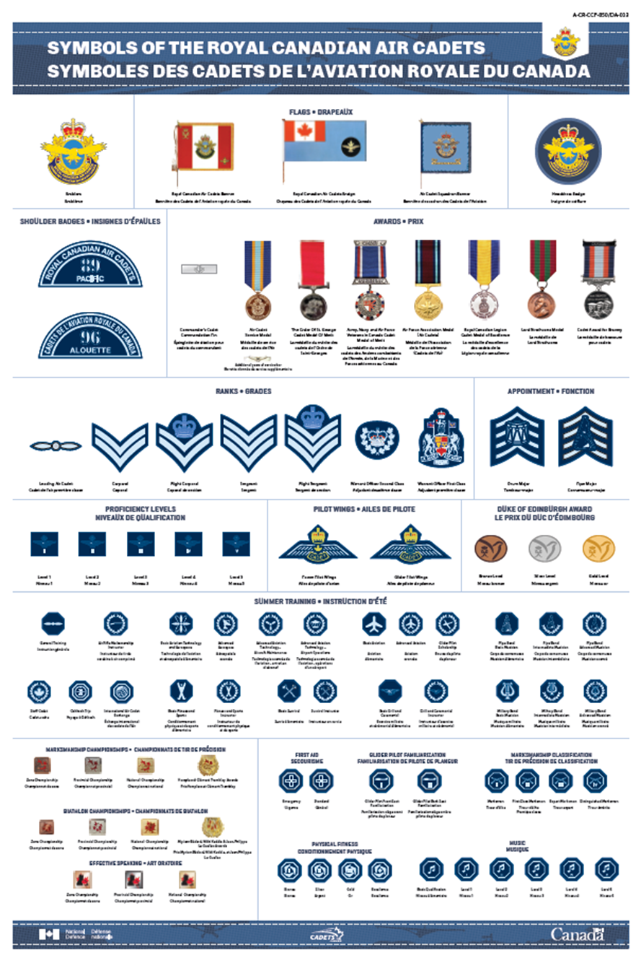
Design and Development – Air Cadets
Paintball, Archery tag, Airsoft or Laser tag (PAAL)
Air Cadet Symbols Poster
Advanced Aerospace Summer
2018 visit

Slide 21

Air Cadet League of Canada - Annual General Meeting

